Slide 1
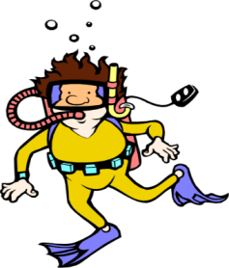
Mrs. Zollshan’s Class Newsletter
November 18th2019
Third Grade
East Rock Magnet School
Ocean of
Events
Diving into Learning
November 4th-25th Food Drive (Peas)
November 20th- Picture Retakes
November 27th- Early Dismissal
November 28th-December 1 Thanksgiving Break
November Birthdays:
Mohammed (9th)
Mrs. Zollshan (16th)
In reading we are continuing to take the scene from our fairy tale and beginning to wrote our play using dialogue and the narrator for story events.
Math is a review of what we have covered so far this year with place value, addition and subtraction with regrouping, comparing numbers and balancing equations. Assessment is THIS WEEK ☺
Fact Fluency is a review of multiplying by 0, 1, 2 and 5. We use skip counting, repeated addition and equal groups to solve.
In writing we are continuing to write a play based on a scene in our fairy tale. We are using descriptive language to convey how our characters feel and describe the events that occur in our scene.
Turkeys are DUE ☺
I can’t wait to see your disguised turkeys this week. We will display them in the class and use them for a writing assignment. Hopefully this helps them escape the Thanksgiving Feast
THIS IS 2 SIDED ->

Slide 2
Picture Retakes
Picture retakes are this Wednesday, November 20th. They ask that you must return the packet with the pictures in order to be scheduled for a retake.
A note from the teacher
If you were unable to attend your conference time please reach out to set up a makeup time or to have a phone conference.
I had a great time meeting with parents last week and talking with you about your students strengths and goals. As I noted in conferences, this week is the math assessment that goes with the back page of the report card.
Specials Schedule
Monday: Music
Tuesday: P.E. and Art
Wednesday: Spanish and Music
Thursday: P.E.
Friday: Spanish and Art
Don’t get stranded! Call or email with any questions that you have!
Elizabeth.zollshan@new-haven.k12.ct.us
Room 123
(203) 503-5900

